Slide 1
User
Username | Charfield
Password | charfield
First_name | Charfield
M 2 0
Product
Title | Charfield
Selling_price | Floatfield
Discounted_price | Floatfield
Description | Textfield
Brand | Charfield
Product_img | Imgfield
category | Charfield
Customer
user | ForeignKey
Name | charfield
Address | Charfield
City | charfield
zipcode | CharField
O 2 M
M 2 O
O2M
O 2 M
O2M
Order Place
User | ForeignKey
Customer | ForeignKey
Product | ForeginKey
Quatity | PositiveIntegerfield
Ordered_date | DateTimeField
satus | Charfield
Cart
User | Forigenfield
Product | Forigenfield
quantity | +integerfield

Slide 2
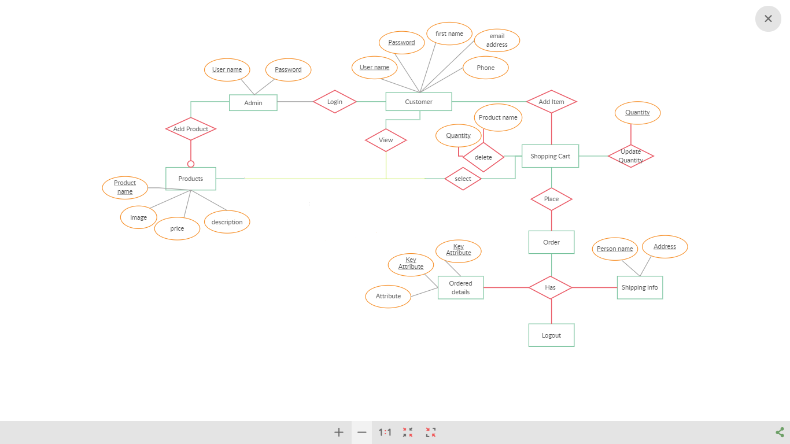

Slide 3
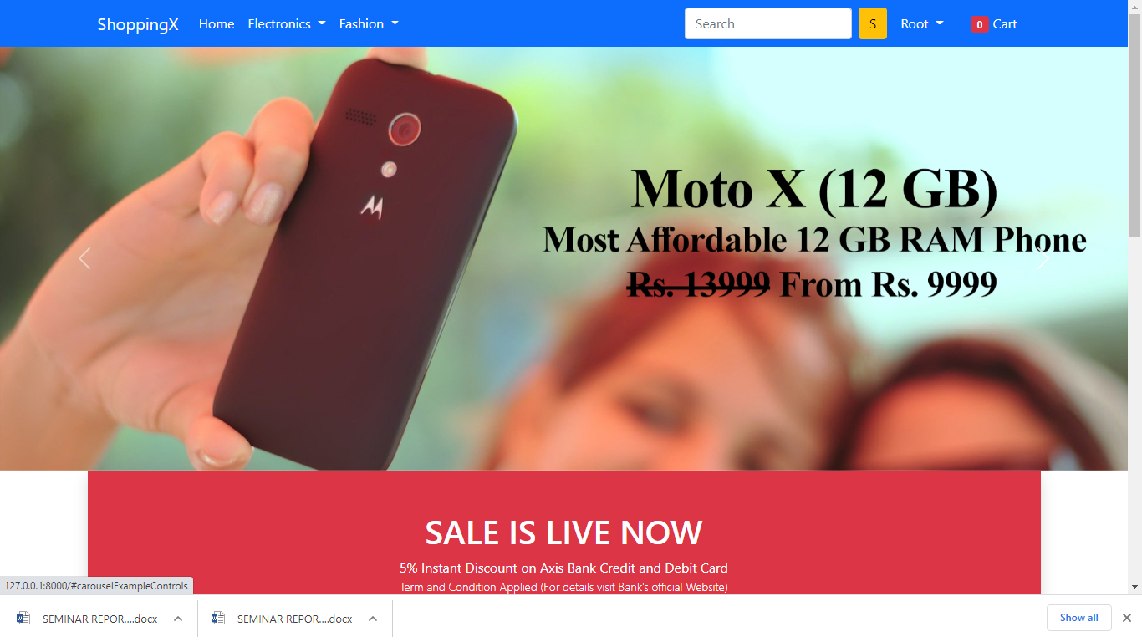

Slide 4
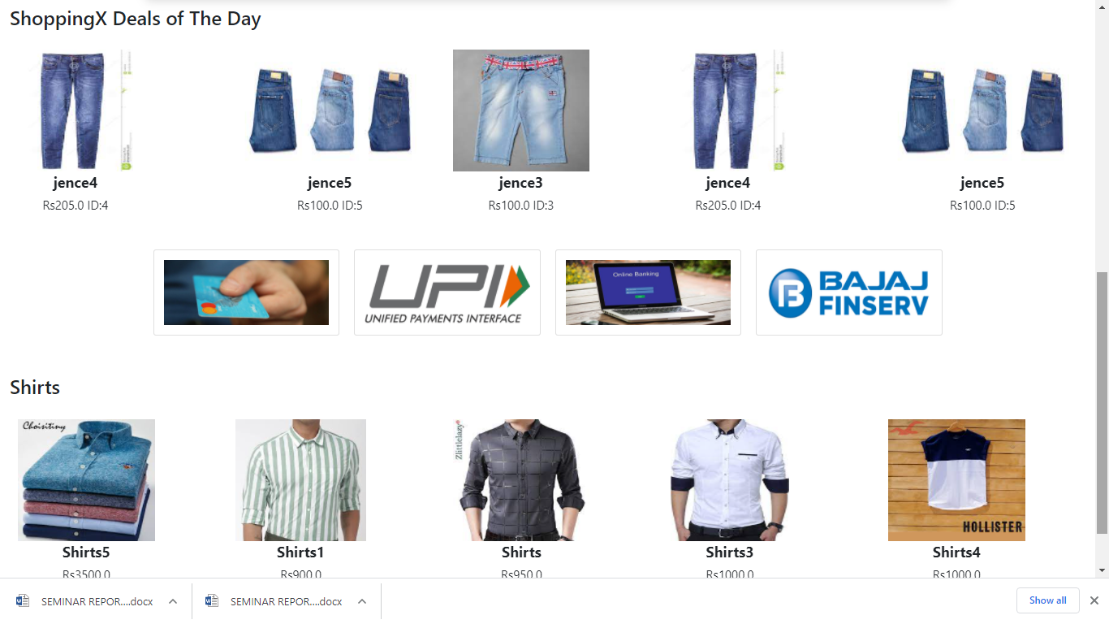

Slide 5
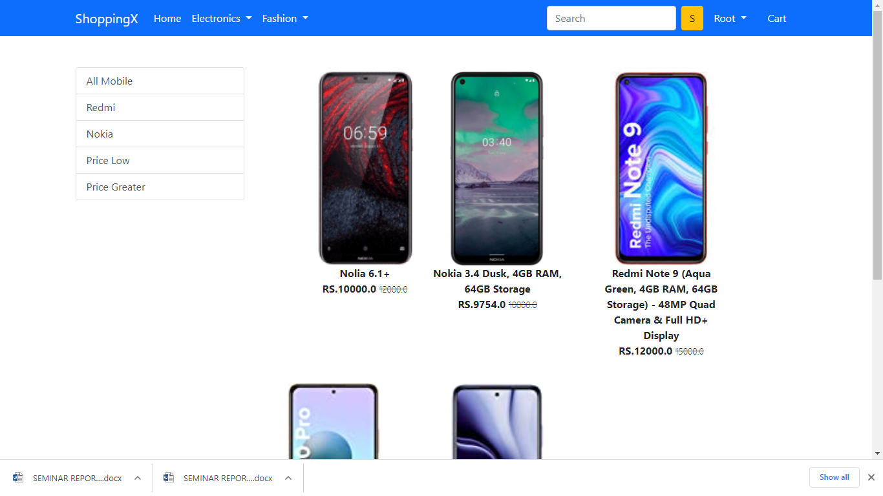

Slide 6
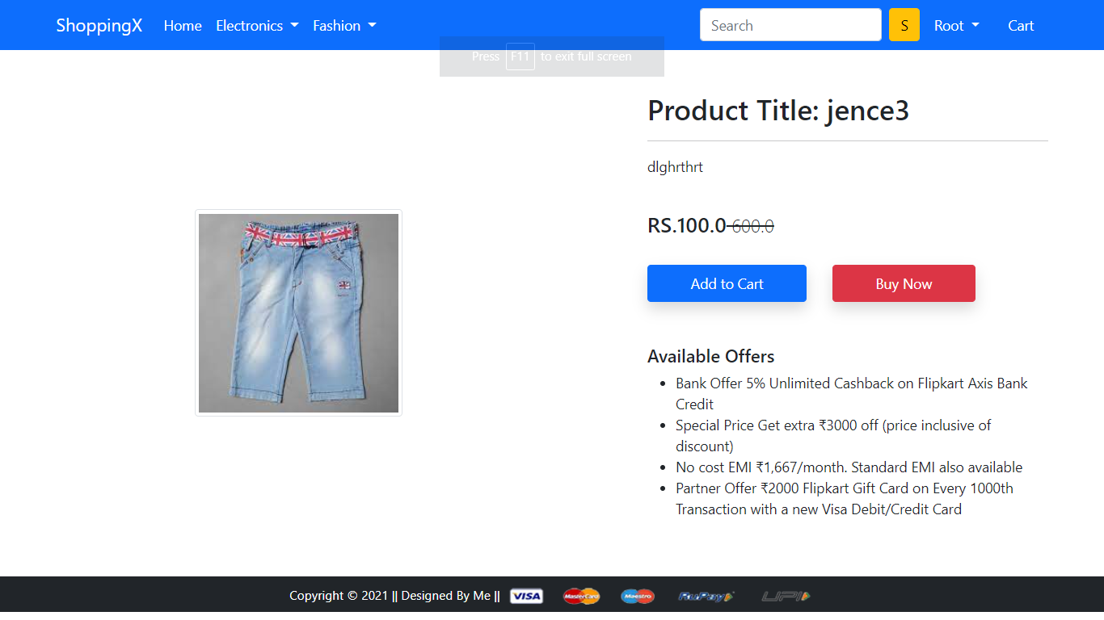

Slide 7
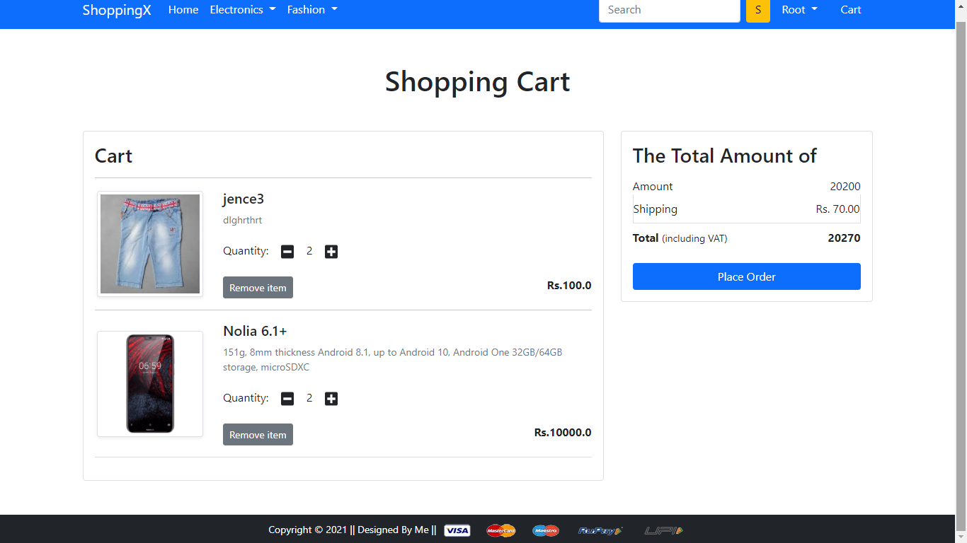

Slide 8
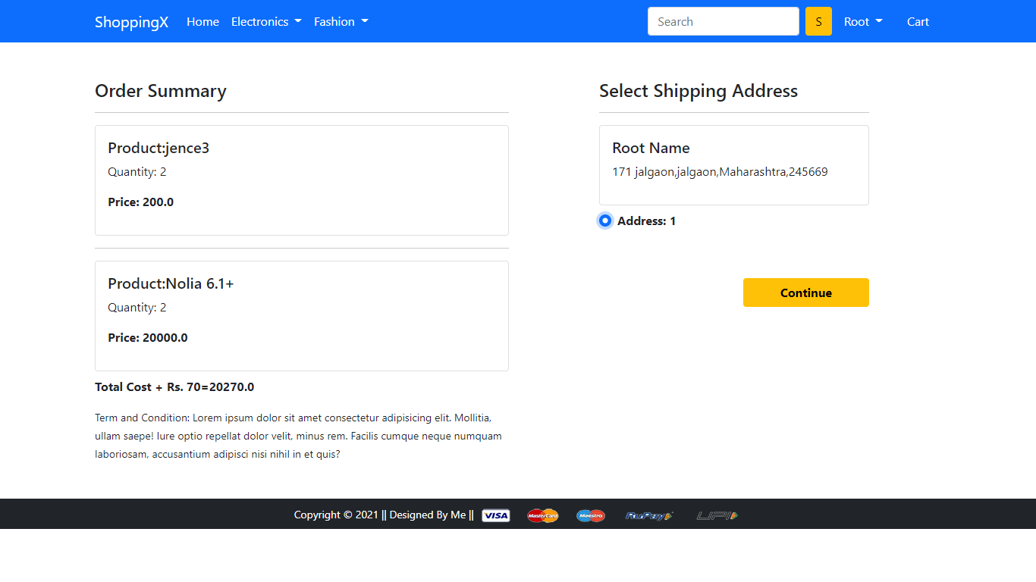

Slide 9
